Slide 1
COVID-19 Predictions using deep learning techniques
Second Capstone Project
Ramesh Sharma
Springboard

Slide 2
Introduction
Coronavirus disease 2019 is known as COVID-19 or 2019-nCoV which is an infectious disease
Corona Virus leads to acute respiratory syndrome in many patients
In this project, we study a fast and efficient way to identify COVID-19 patients with multitask deep learning (DL) methods

Slide 3
Dataset
Github repository for the 2019 Novel Coronavirus Visual Dashboard operated by the Johns Hopkins University Center for Systems Science and Engineering (JHU CSSE https://github.com/CSSEGISandData/COVID-19)

Slide 4
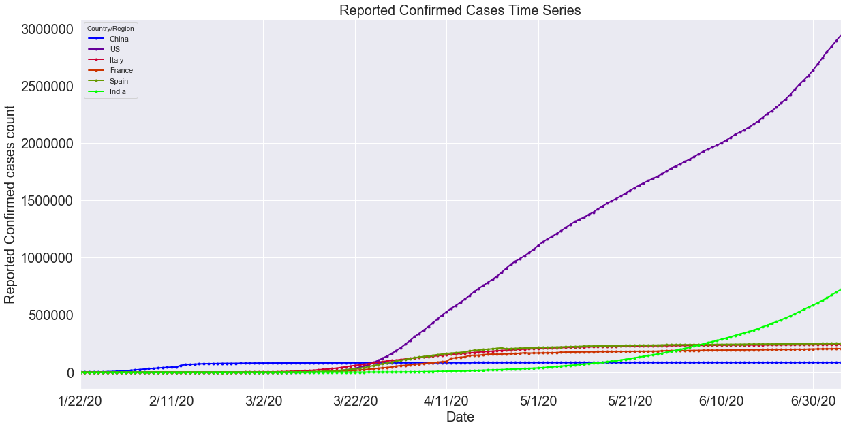
Time Series Plot of reported confirmed cases

Slide 5
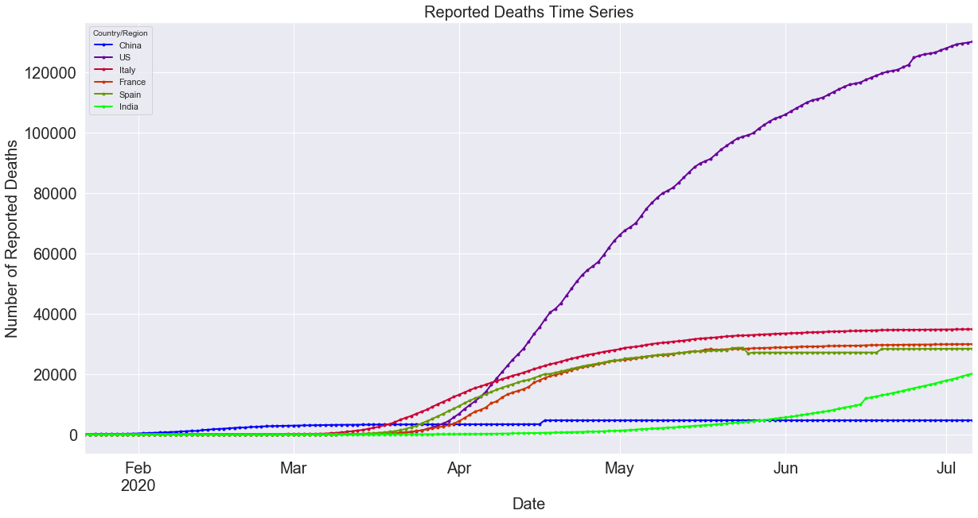
Time Series plot of reported deaths

Slide 6
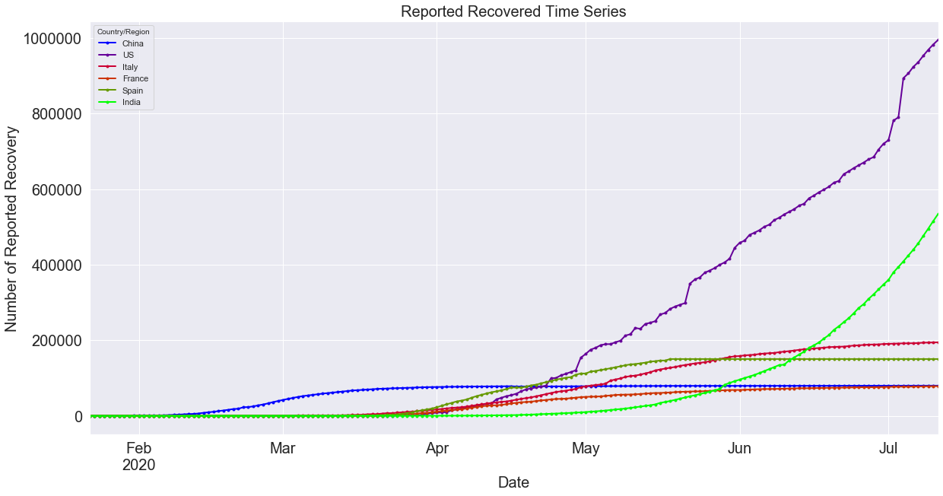
Time Series plot of reported no of recoveries

Slide 7
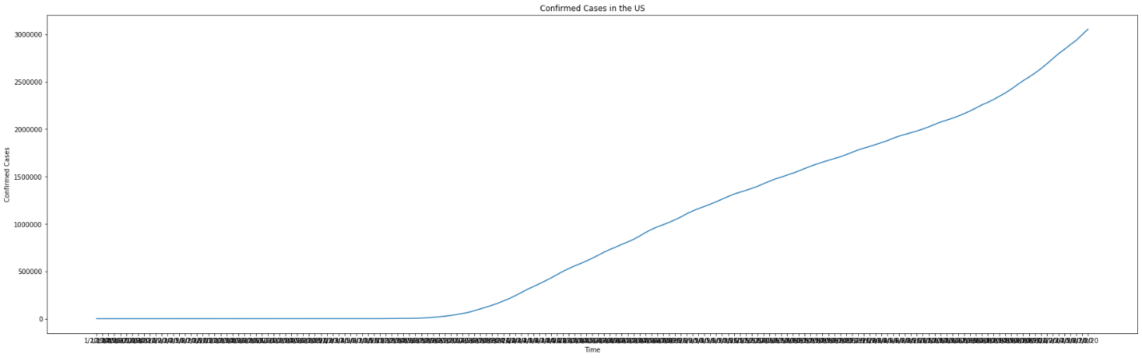
Time Series plot of US Confirmed Cases

Slide 8
Augmented Dickey Fuller Test
The augmented dickey-fuller test is a type of statistical test called unit root test. Unit root test helps to find out the trend on time series dataset.
The null hypothesis of the test is that the time series can be represented by a unit root, that it is not stationary (has some time-dependent structure). The alternate hypothesis (rejecting the null hypothesis) is that the time series is stationary.
Comparing the result of test using statsmodel module of python, test statistic to the critical values, it looks like we would have to fail to reject the null hypothesis that the time series is non-stationary and does have time-dependent structure.

Slide 9
Long Short Term Memory Model
The Long Short Term Memory neural network is a type of a Recurrent Neural Network (RNN).
RNNs use previous time events to inform the later ones.
It has an LSTMCell unit and a linear layer to model a sequence of a time series.
The model can generate the future values of a time series

Slide 10
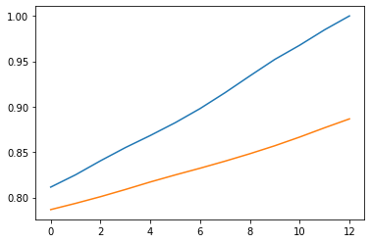
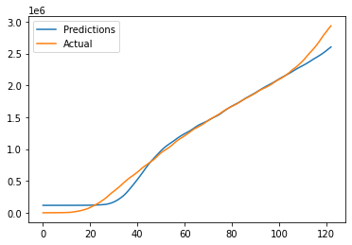
Model Results

Slide 11
Conclusions
2019 coronavirus dataset (January‐July 2020), COVID‐19 (nCOV‐19) coronavirus spread dataset, and 2019‐nCoV dataset can be useful to monitor and predict the emerging outbreaks, such as 2019‐nCoV.
Can help us to generate and disseminate detailed information to the scientific community, especially in the early stages of an outbreak, when there is a little else available, allowing for independent assessments of key parameters that influence interventions.
Observe that deep learning techniques can be used to predict the future time series prediction of COVID-19 allowing health care sectors and health authorities take necessary steps at right time to mitigate the adverse impact of virus.

